Slide 1

CONNECT FOUR AI
Implementation & Performance Analysis
Luke Sims, Om Malkan, Matthew Ayala
CSCI.331 | Rochester Institute of Technology | Group 8 | November 25, 2025

Slide 2

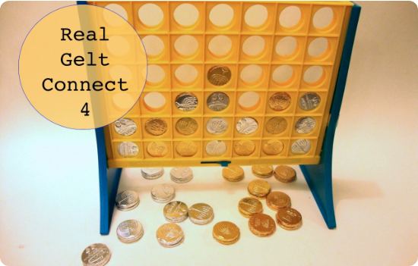
GAME OBJECTIVE
Connect Four is a two-player connection board game, in which the players take turns dropping colored discs from the top into a seven-column, six-row vertically suspended grid.
Goal: Connect four of one's own discs of the same color next to each other vertically, horizontally, or diagonally.
Nature: It is a zero-sum, perfect information game, making it an ideal candidate for adversarial search algorithms.
Notes:
matthew

Slide 3
PROBLEM & HYPOTHESIS
OUR HYPOTHESIS
THE CHALLENGE
We hypothesize that the Alpha-Beta Pruning algorithm will significantly outperform the standard MinMax algorithm.
To implement an AI agent capable of playing Connect Four at a competitive level, balancing search depth with execution time constraints.
Prediction: Alpha-Beta will allow for deeper search depths within the same time limit by eliminating non-optimal branches.
Notes:
Matthew

Slide 4

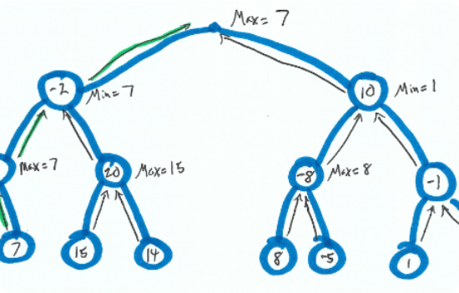
MinMax Implementation
NegMax
Instead of the usual alternating MinMax tree neg max only uses 1 type of node. The node always maximizes but when the value back up it negates it. This makes the implementation simpler but can only be used when a players score can be interpreted as the opposite of the other players.
Depth Limit: Due to the game's complexity (4.5 trillion positions), we implement iterative deepening to a fixed depth.

Slide 5
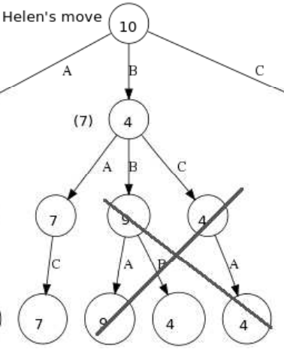
AlphaBeta pruning
AlphaBeta
We can still use the NegMax idea with AlphaBeta. To do this in the recursive call we negate both Alpha and beta so it looks something like this:
-alphabeta(-beta, -alpha, next_posistion)
Slight optimization was done by starting the search in the middle of the tree and then going outwards

Slide 6
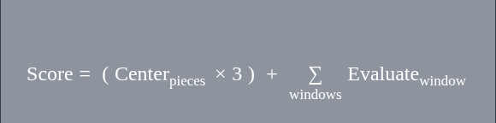
HEURISTIC STRATEGY
EVALUATING LEAF NODES
When the search reaches the depth limit, we calculate a score based on the board state:
Center Control: Higher weight given to the center column (more potential connections).
SCORING FORMULA
Window Evaluation: We scan 4-slot windows across the board:
4 pieces: +100 (Win)
3 pieces + 1 empty: +5
2 pieces + 2 empty: +2
Opponent 3 pieces: -4 (Block priority)

Slide 7
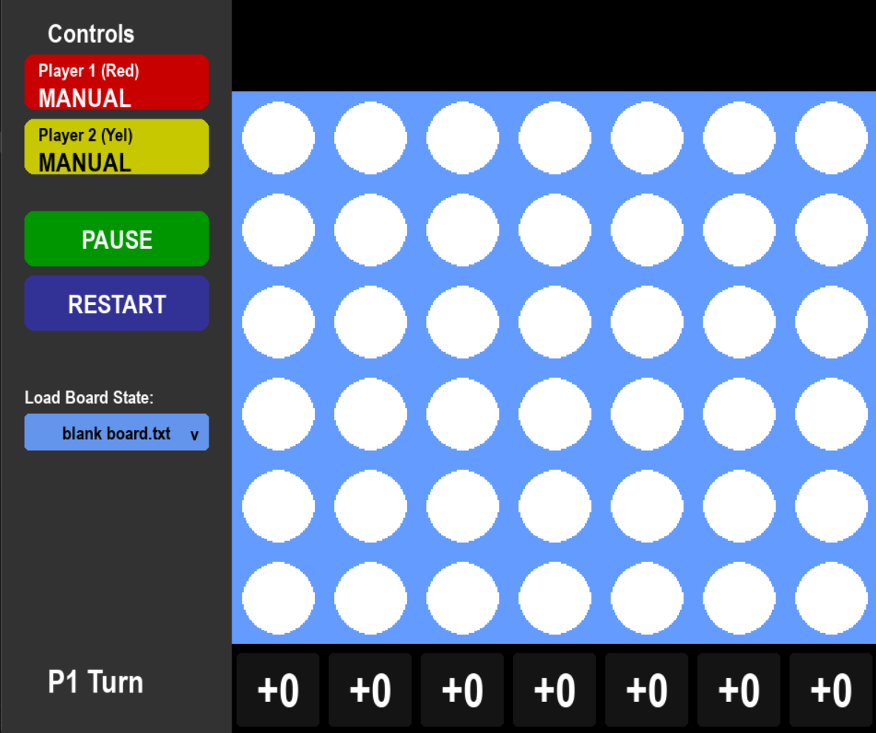
GUI IMPLEMENTATION
INTERACTIVE FEATURES
Built using Python and Pygame, our interface provides real-time control and feedback:
Player Modes: Toggle P1/P2 between Human and Bot via sidebar.
Game Control: Dedicated Pause and Restart buttons for seamless testing.
Live Heuristics: A dynamic bar showing the AI's evaluation (-2 to +2) for each column.
State Loading: Dropdown menu to load valid board states from file.
Notes:
Luke

Slide 8
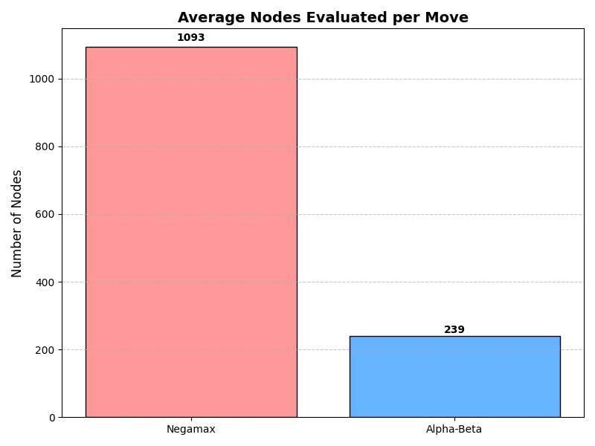
RESULTS: SEARCH EFFICIENCY
Alpha-Beta Pruning evaluates 4.56x fewer nodes than Negamax, proving it successfully eliminates irrelevant branches of the game tree.
Notes:
Luke

Slide 9
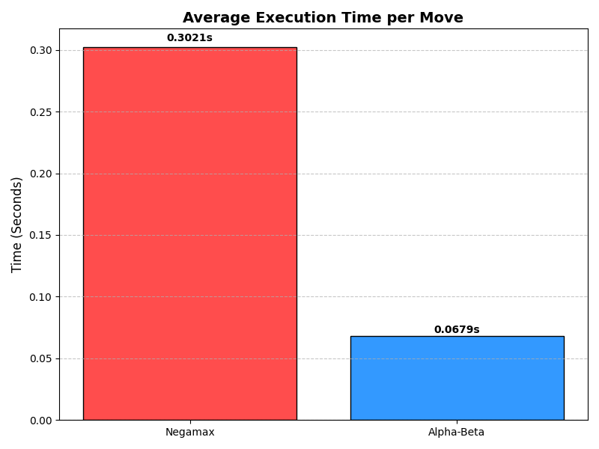
RESULTS: EXECUTION SPEED
Alpha-Beta achieves a 4.25x speedup. This efficiency allows the AI to search deeper in the same time Negamax takes for less nodes
Notes:
Luke

Slide 10
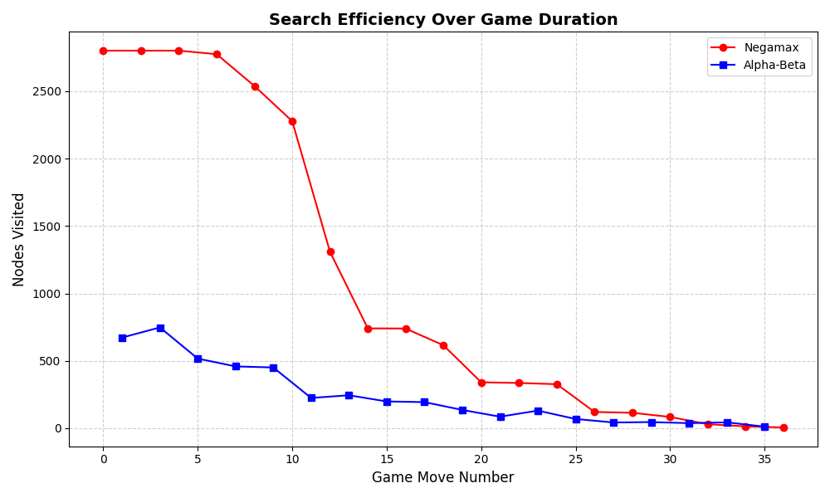
RESULTS: Nodes Per Move Over Time
The implementation of Alpha-Beta pruning show significant and consistent improvement vs. the Negamax algorithm
Notes:
Luke

Slide 11
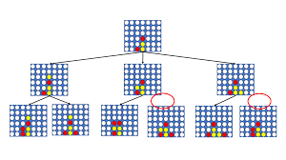
LIMITATIONS
This implementation recalculates the score for every board state it finds. This is redundant and adding a cache system such as a transposition table would improve performance.
The AI agent will always perform the best possible move, making it’s moves predictable. The lack of randomness makes it possible to beat the bot consistently.
Notes:
Matthew

Slide 12
CONCLUSION
HYPOTHESIS CONFIRMED
The data conclusively supports our hypothesis. Alpha-Beta Pruning is not just an optimization; it is essential for a responsive Connect Four AI.
By effectively pruning the search space, we can increase the difficulty and foresight of the bot without degrading the user experience.
Notes:
Matthew

Slide 13
QUESTIONS?
Thank you for your time.
References: Russell, S., & Norvig, P. (2020). Artificial Intelligence: A Modern Approach. CSCI 331 Course Materials Code by Group 8

Slide 14
SOURCES
“Solving Connect 4: How to Build a Perfect AI.” Solving Connect 4: How to Build a Perfect AI, blog.gamesolver.org/. Accessed 14 Nov. 2025.
Allan, Sean. “Connect 4 Game Theory Analysis: Exploring Mathematical Strategies.” SiamMandalay, 24 Apr. 2024, www.siammandalay.com/2024/04/24/connect-4-mathematical-strategy/?srsltid=AfmBOoqhAF7esQ1xM2q-gzV3AqN85u-aUr-MopDz7alOGgsKuG8QZDxS.
Way Too Simple. “ How to Win Connect 4 Every Time.” YouTube, YouTube, www.youtube.com/watch?v=v6N0JGmi1W4. Accessed 19 Nov. 2025.
Cahn, Lauren. “How to Win Connect 4 Every Time, According to the Computer Scientist Who Solved It.” Reader’s Digest, 18 July 2025, www.rd.com/article/how-to-win-connect-4/.

